Slide 1
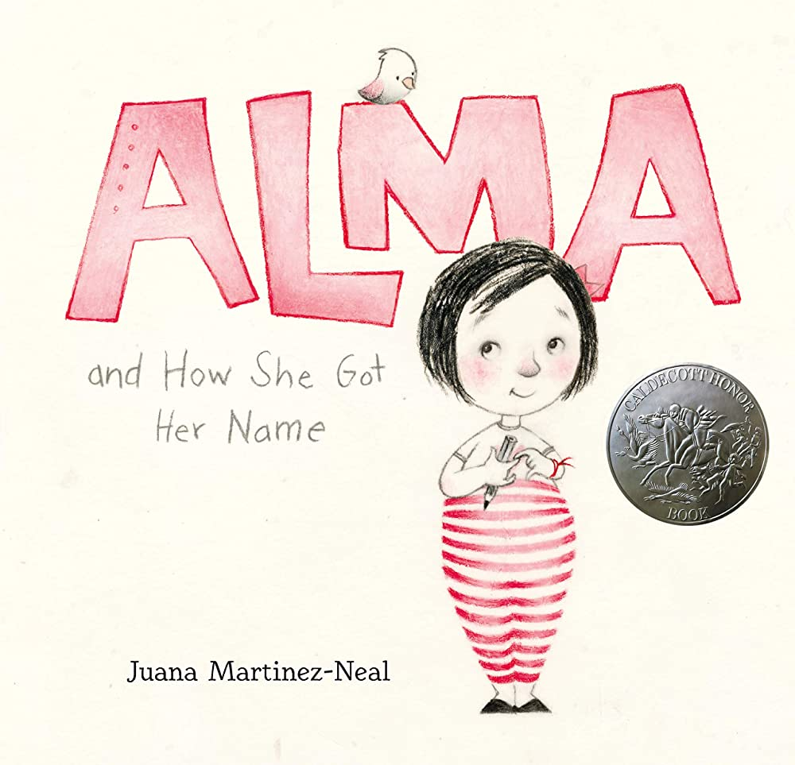

Slide 2


Slide 3
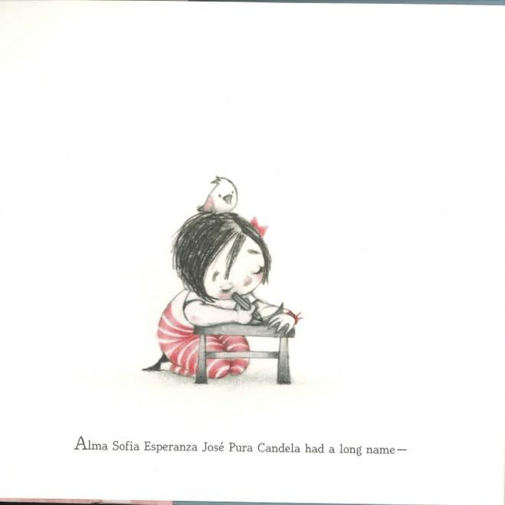
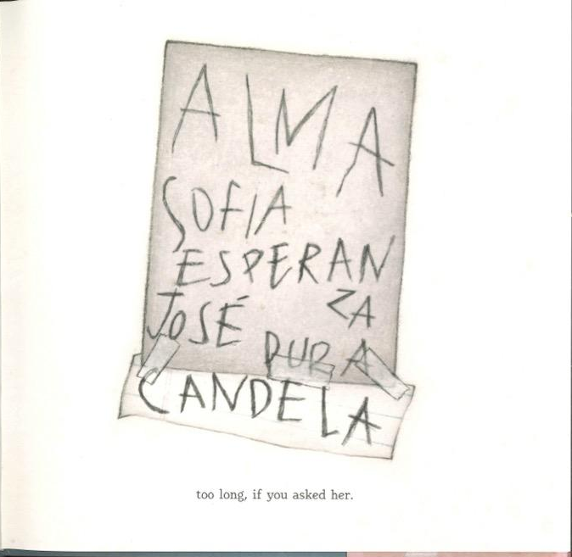
1 Alma’s name was very long. 2

Slide 4
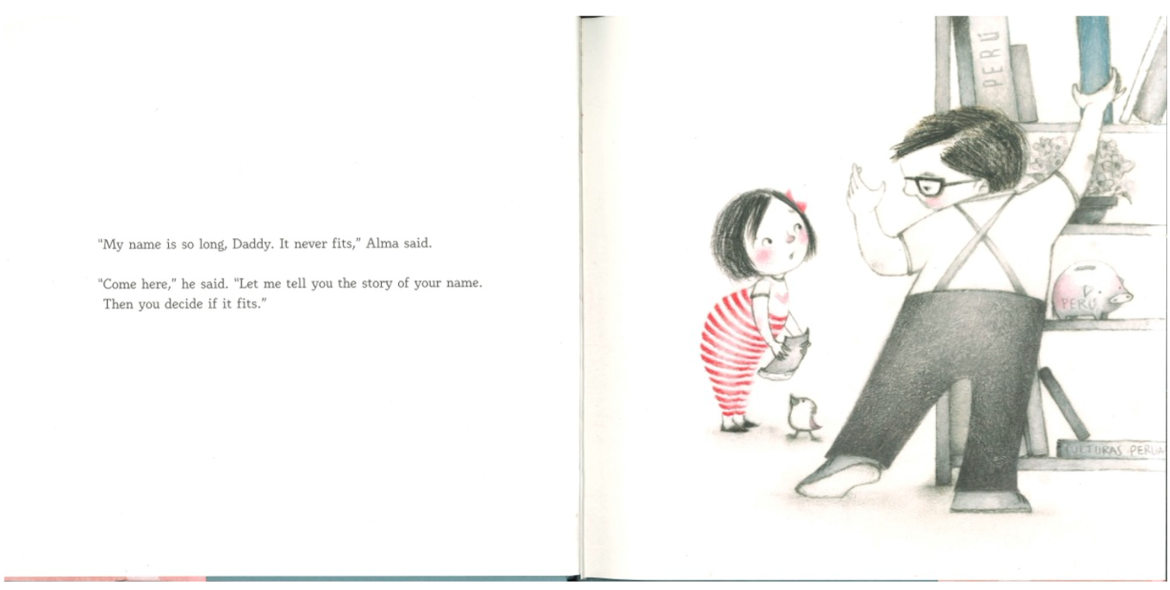
Alma’s Daddy told her a story about her long name.
3 4

Slide 5
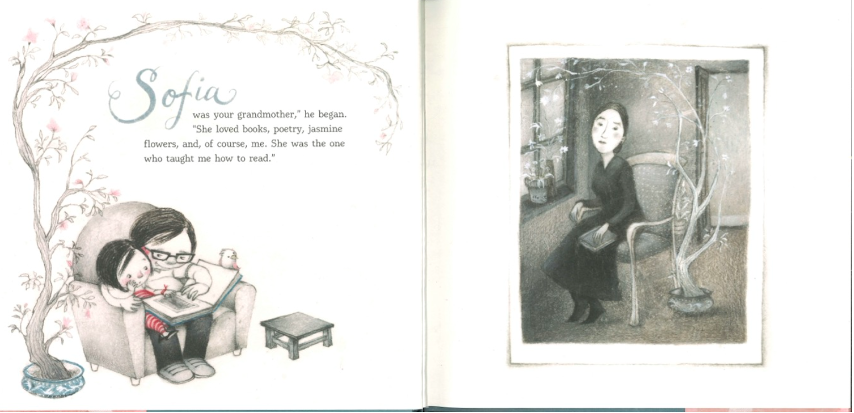
Sofia was Alma’s grandmother. She liked flowers and books.
5 6

Slide 6
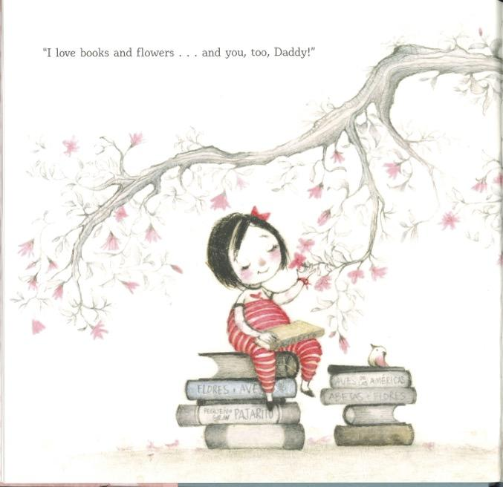
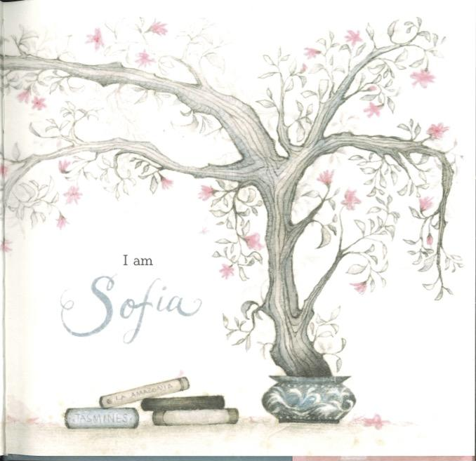
7 Alma likes books and flowers just like her grandmother Sofia. 8

Slide 7
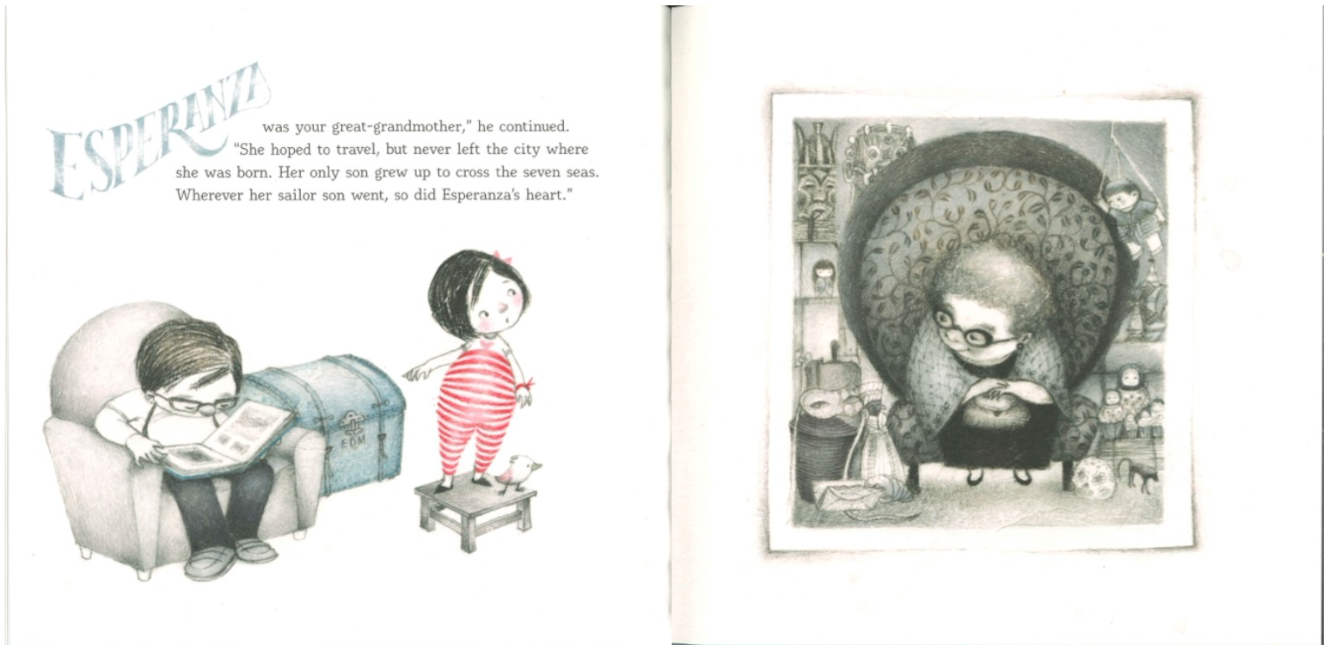
Esperanza was Alma’s great-grandmother. She wanted to travel the world.
9 10

Slide 8

Alma wants to see the world too.
11 12

Slide 9
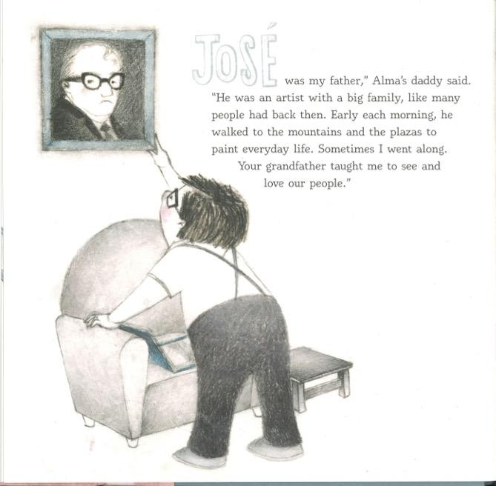
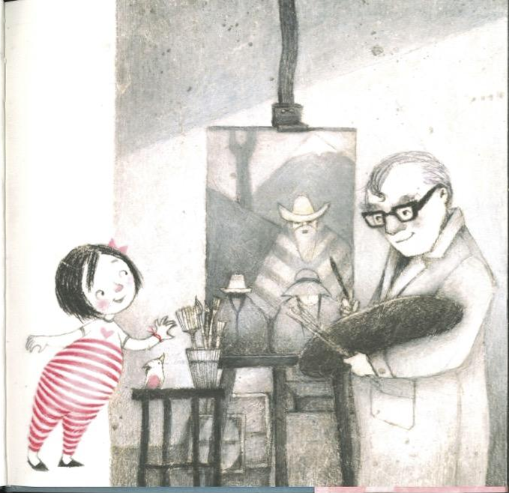
13 José was Alma’s grandfather. He was an artist. 14

Slide 10
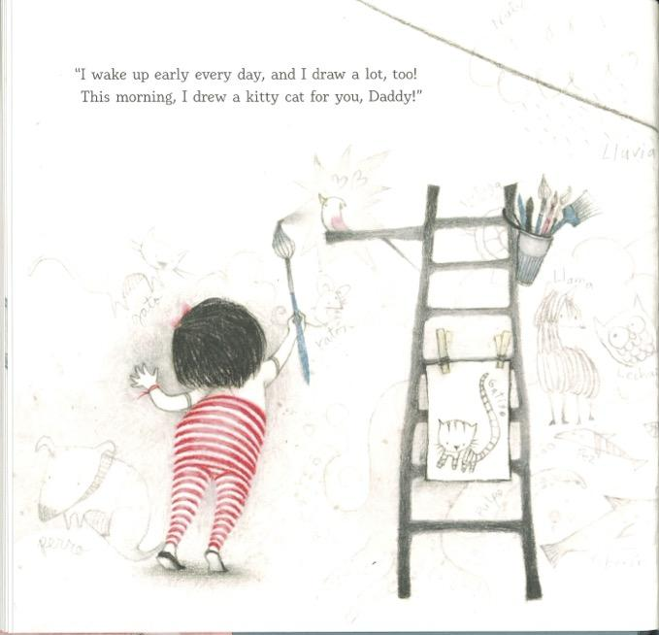
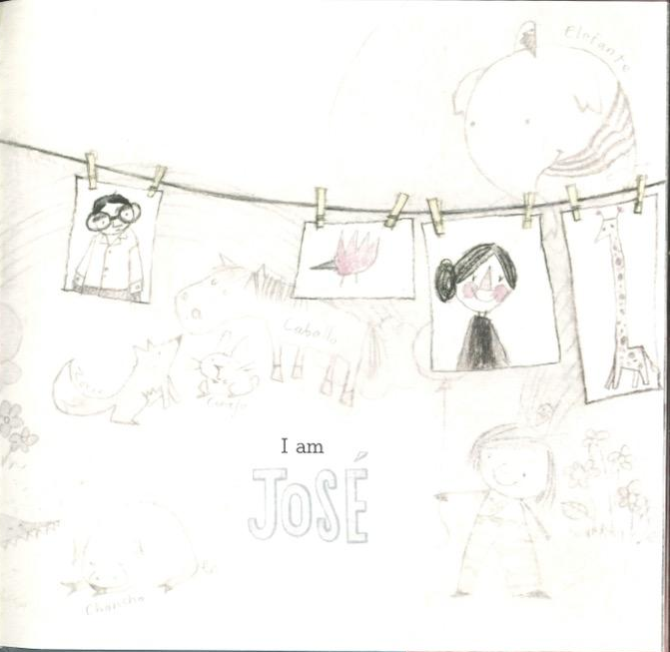
15 Alma loves to paint too! 16

Slide 11
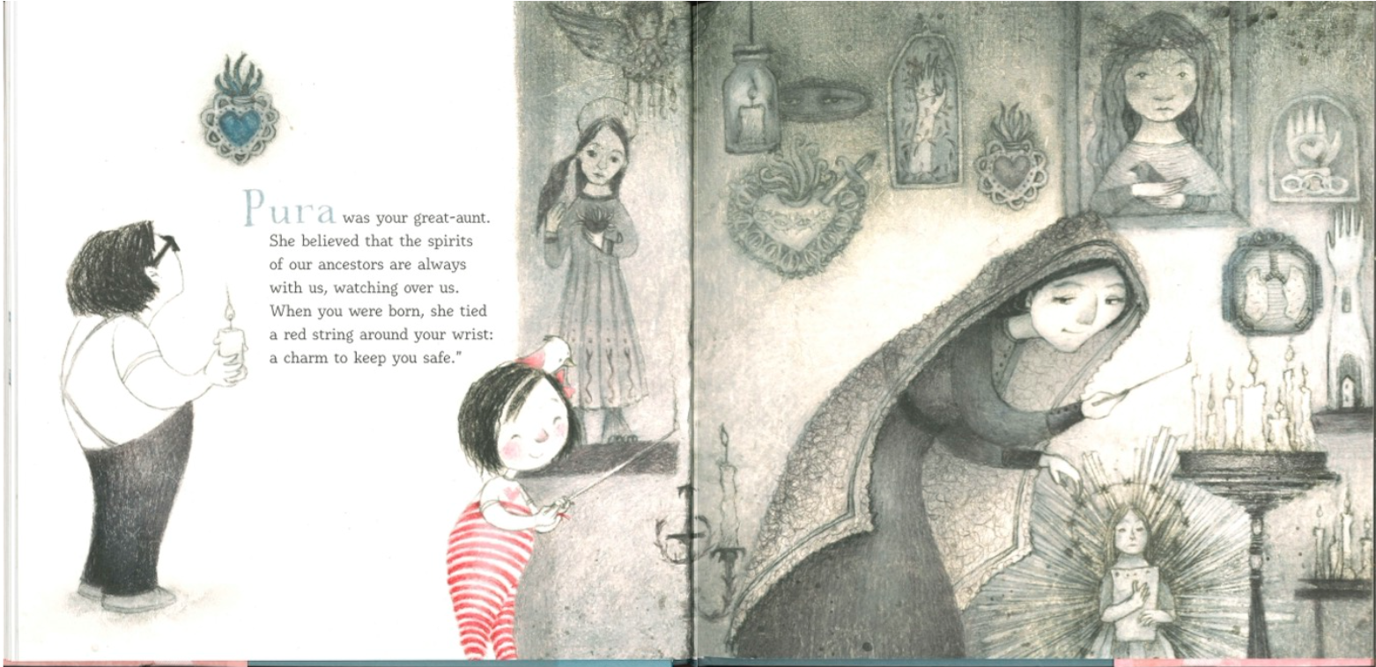
Pura was Alma’s great-aunt. She took care of the ancestors in their family.
17 18

Slide 12
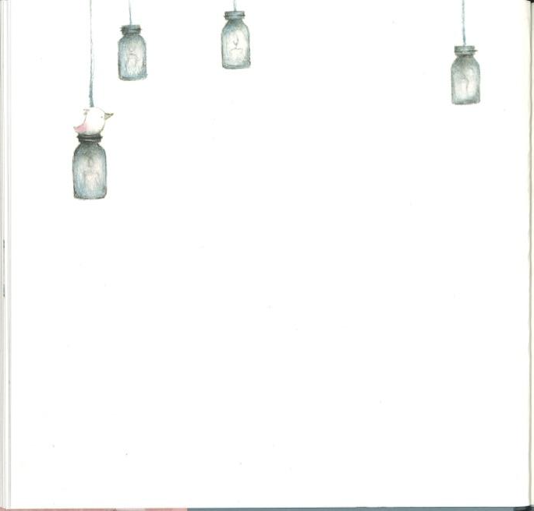
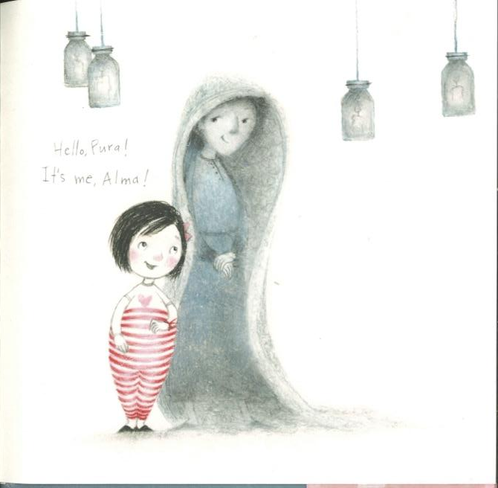
19 Alma says hello to her Aunt Pura’s spirit. 20

Slide 13

Candela was Alma’s other grandmother. She always helped people.
21 22

Slide 14
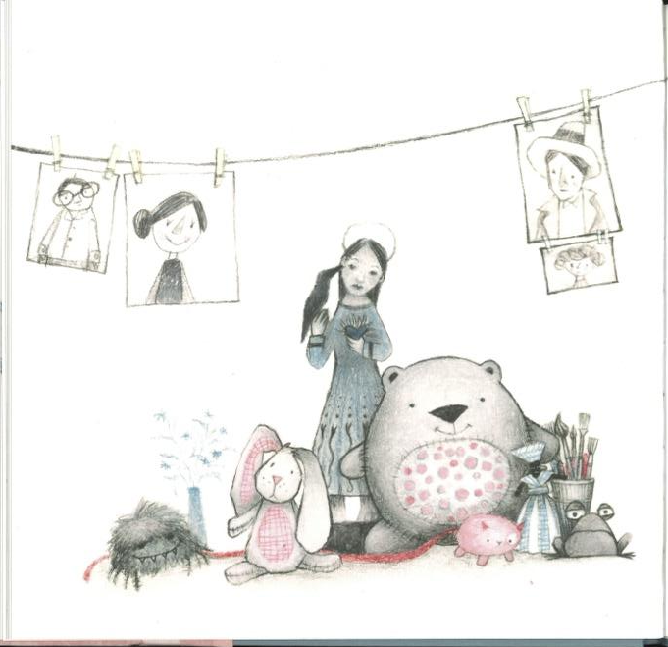
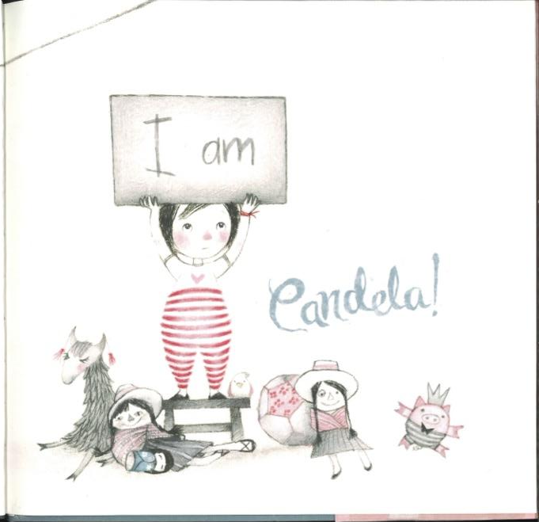
23 Alma likes to help people too. 24

Slide 15
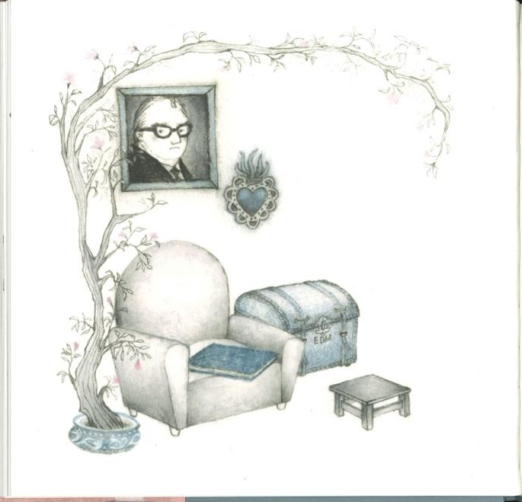
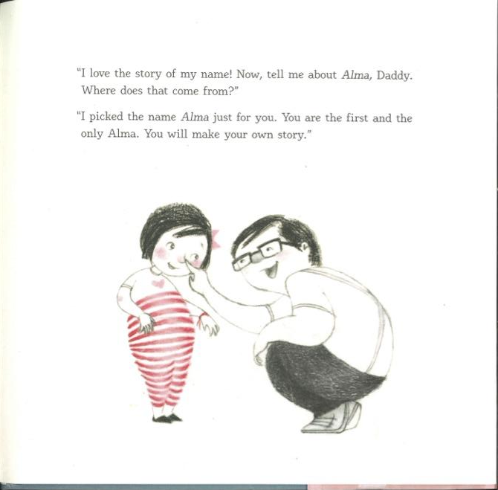
25 Daddy says she was the only Alma. 26

Slide 16

Alma loves the story of her long name, Alma Sofia Esperanza José Pura Candela!
27 28

Slide 17
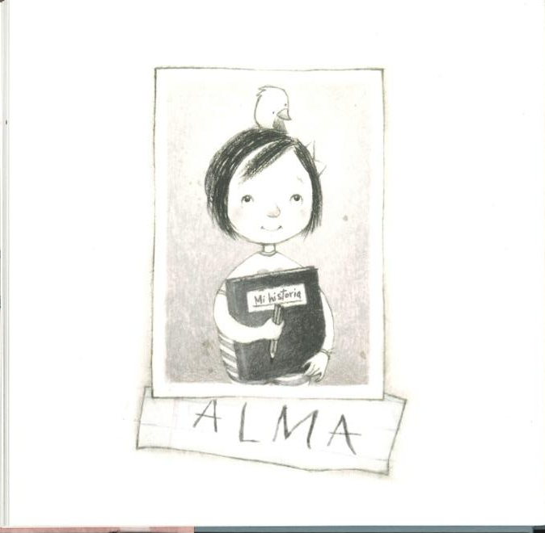
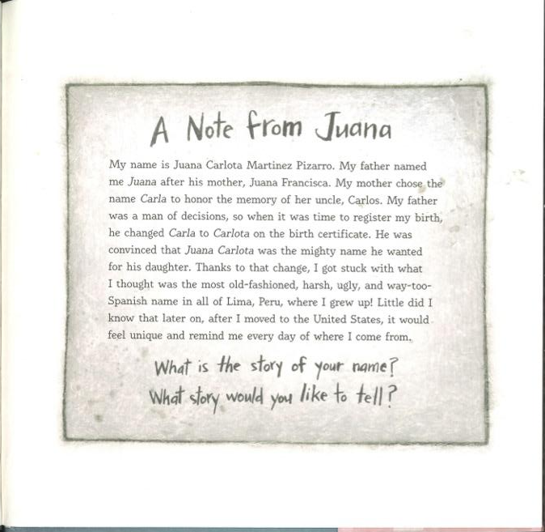
29 30

Slide 18
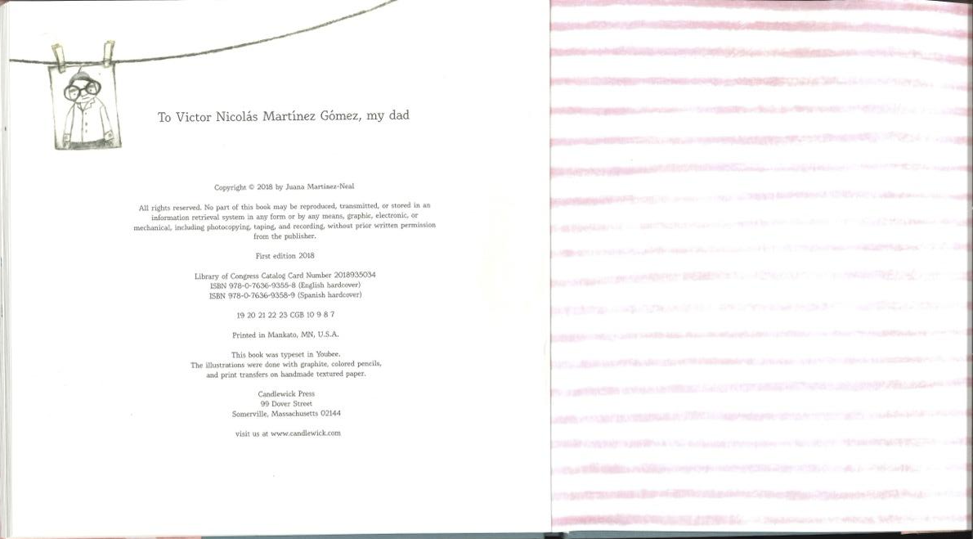

Slide 19
